Slide 1
NextHikes IT Solutions
Exploratory Data Analysis & Revenue Forecasting
Industry Data · Manisha Nagda

Slide 2
Project Goals
Understand the Data
Derive Business Insights
Build Predictive Models
Explore distributions, correlations, and anomalies across 15,000 company records spanning 5 industries and 4 countries.
Identify key revenue determinants and translate statistical findings into actionable recommendations for stakeholders.
Train and evaluate machine learning models to forecast corporate revenue and support data-driven decision-making.

Slide 3
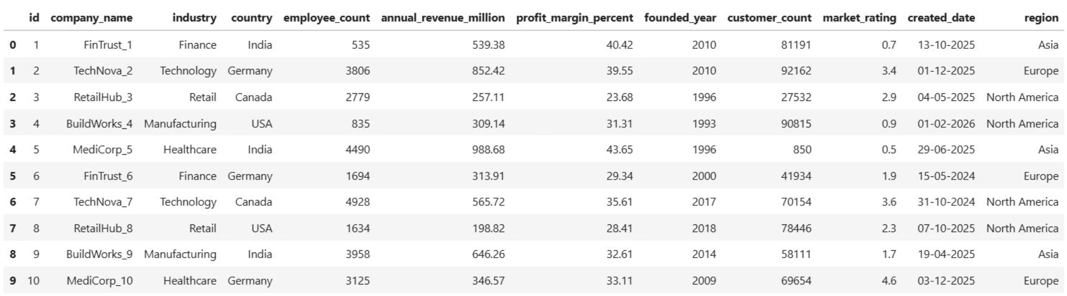
Dataset Overview
A comprehensive dataset of 15,000 company records across 5 industries and 4 countries, with 12 original features covering financial, operational, and categorical dimensions.
15K
12
Total Records
Original Features
Companies across all sizes
Financial & operational variables
5
4
Industries
Countries
Diverse sector coverage
Multi-regional representation

Slide 4
Data Preparation & Feature Engineering
Data Preparation
Engineered Features
No missing values across 12 columns
No duplicates in 15,000 rows
created_date converted to datetime
founded_year replaced by company_age (2026 − year)
All columns validated for correct data types
company_age — 2026 − founded_year
customers_per_employee — customer_count / employee_count
revenue_per_employee — revenue / employee_count
revenue_per_customer — revenue / customer_count
absolute_profit_million — revenue × profit_margin / 100
profit_per_employee — profit / employee_count
company_size_category — Binned employee_count (quantile)
created_year / month — Extracted from created_date

Slide 5
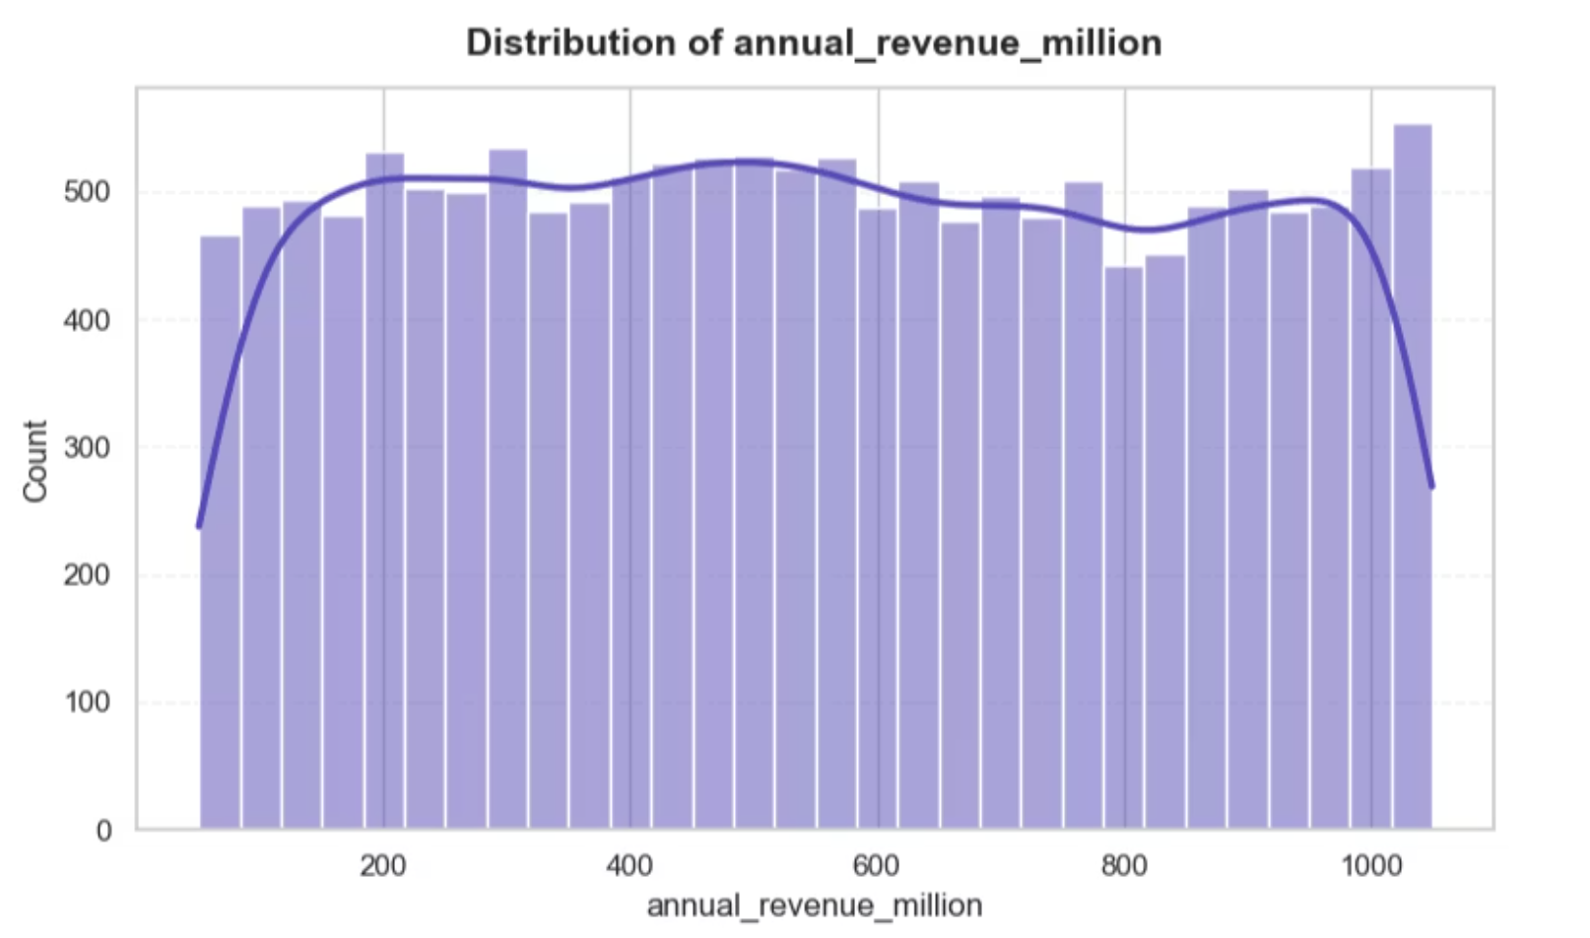
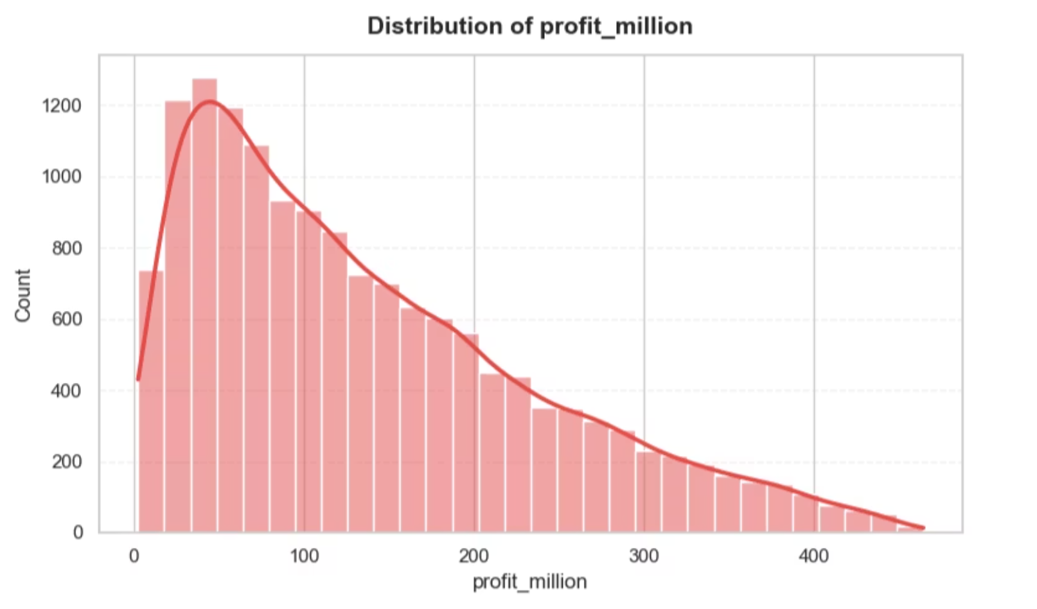
Univariate Analysis
Distribution of annual revenue and absolute profit across the dataset.
Annual revenue is nearly uniform (skewness ≈ 0.03), spanning $50M–$1,050M evenly
Absolute profit is positively skewed — most firms earn modest margins, with a long right tail of high-margin outliers

Slide 6
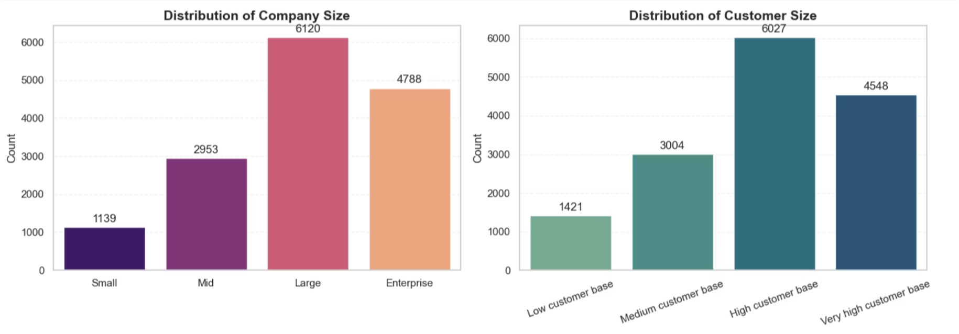
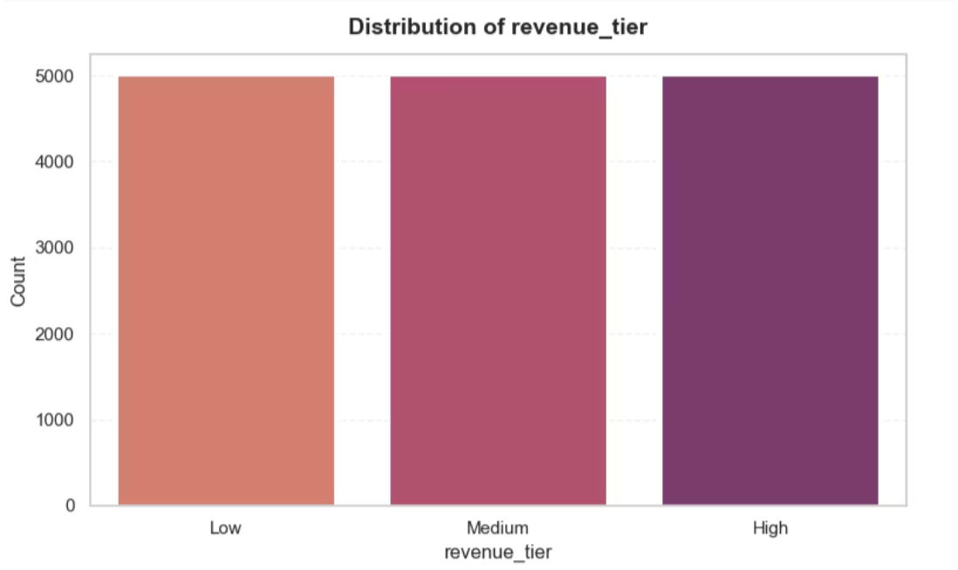
Categorical Analysis
The size of the companies lean towards Large (6,120) and Enterprise (4,788), showing that the dataset is mostly comprised by medium-to-large companies. The distribution of the customers base follows the same pattern.
The revenue tier is evenly split with 5,000 records each, underscoring the artificial, controlled nature of the data.
No single industry, country, or region consistently dominates, further confirming the balanced and synthetic nature of the dataset.

Slide 7
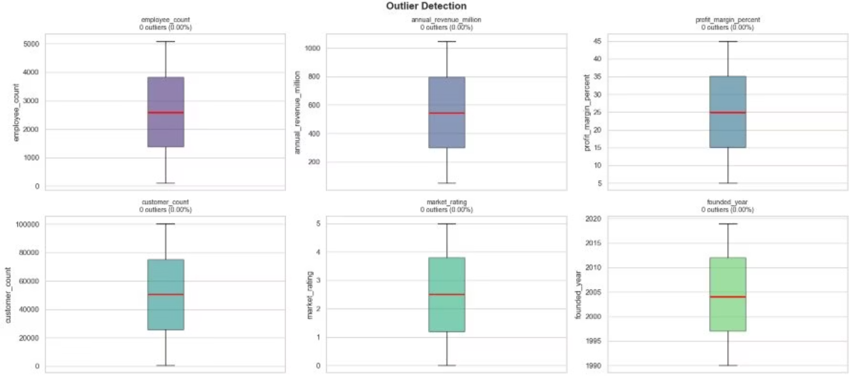
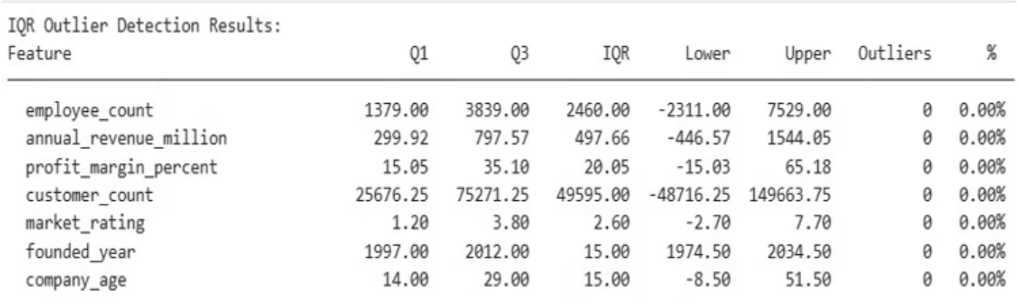
Outlier Detection
Methods Applied
IQR Method: Interquartile range bounds
Z-Score Method: Standard deviation thresholds
Boxplot Visualization: Visual confirmation
No outliers were identified for any of the numerical variables based on the IQR method and Z-score. All values are within the acceptable range. As the count of outliers is 0% in all the cases, no treatment was required. The data is clean and can be used for modeling.

Slide 8
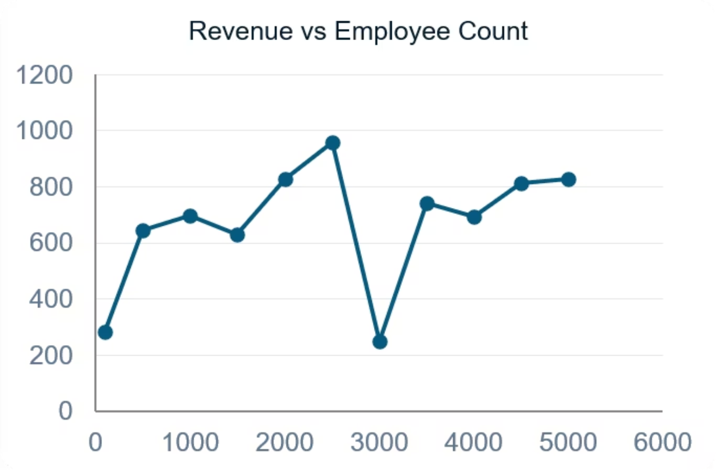
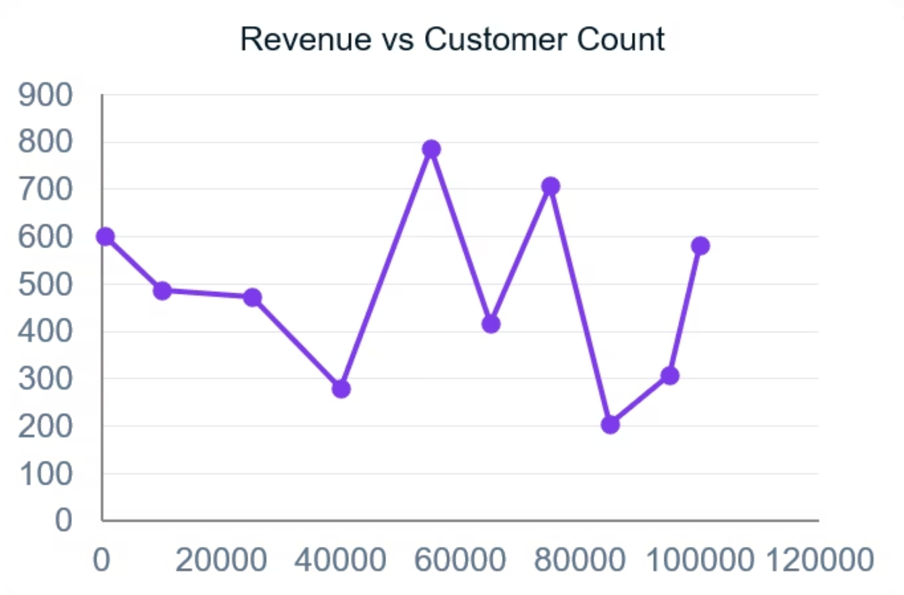
Bivariate Analysis
Scatter plots between annual revenue and the number of employees, and between annual revenue and number of customers do not show any obvious pattern. Revenue moves independently at all organizational sizes, validating the weak correlations found in the correlation analysis. Size of staff and size of customer base are not significant predictors of revenue in this data set.

Slide 9
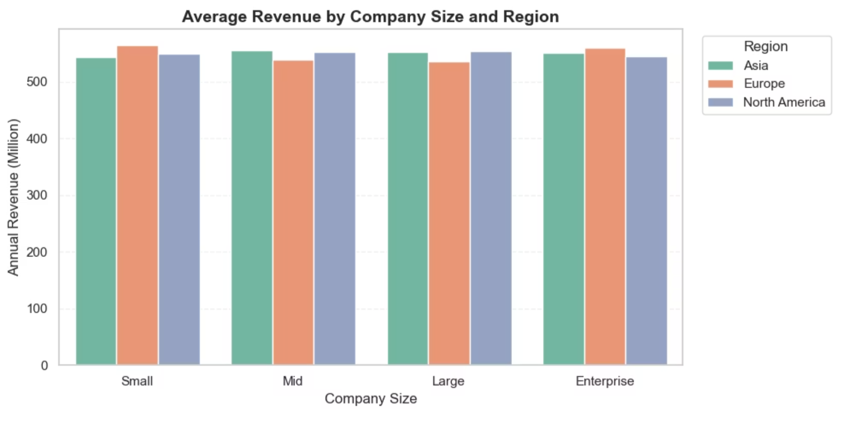
Multivariate Analysis
Income is stable across all size and region combinations of firms.
There is no sign of an interaction effect size and region do not jointly explain the variation in revenues, further corroborating the finding that important predictor variables are excluded from this data set.

Slide 10
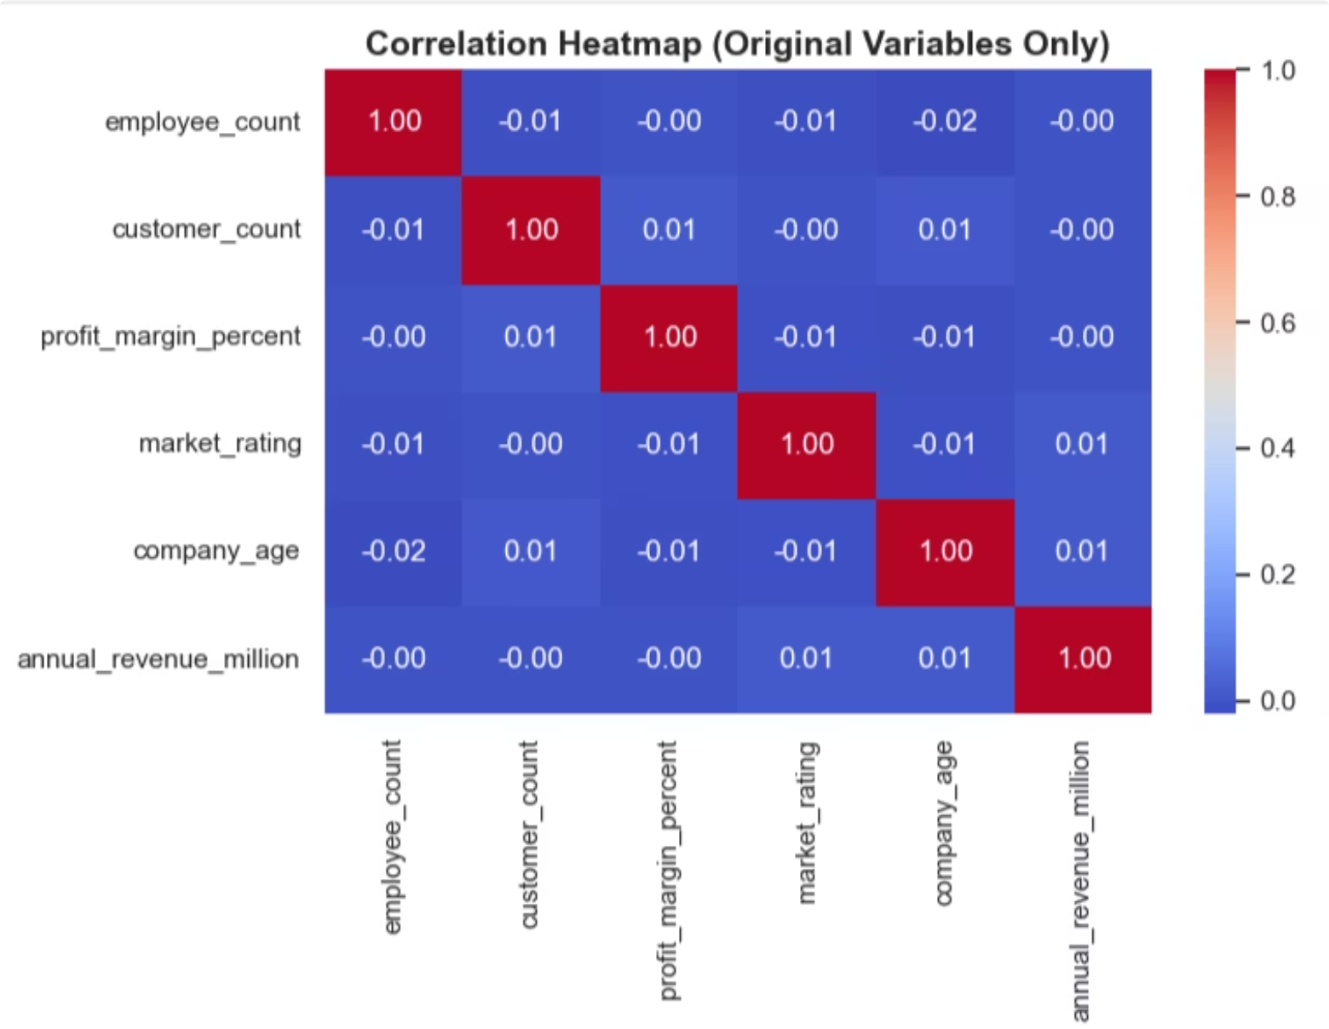
Correlation Analysis
Correlation summary
Pearson correlation
Absolute correlation
market_rating
0.01464
0.01464
founded_year
-0.01184
0.01184
profit_margin_percent
-0.00312
0.00312
customer_count
-0.00267
0.00267
employee_count
-0.00204
0.00204
All features have near zero correlations. No one factor can tell why one company makes more than the other. That is the biggest result of the entire project.

Slide 11
Feature Selection for Machine Learning
Target: annual_revenue_million
Features Used for ML
Excluded because of Data Leakage
Also Dropped
employee_count
profit_margin_percent
customer_count
market_rating
company_age
customers_per_employee
created_year / created_month
company_size_category (encoded)
industry, country, region (encoded)
id, company_name (identifiers)
founded_year (replaced by company_age)
created_date (replaced by year/month)
revenue_per_employee (contains target)
revenue_per_customer (contains target)
absolute_profit_million (contains target)
profit_per_employee (indirect leakage)

Slide 12
Machine Learning Models
Five regression algorithms trained and compared
Model
RMSE
MAE
R²
Linear Regression
287.203
248.339
-0.0003
Decision Tree
290.067
250.219
-0.0204
Random Forest
287.572
248.573
-0.0029
Gradient Boosting
289.106
249.199
-0.0136
Extra Trees
291.622
250.215
-0.0313
Linear Regression attained the largest R² (−0.0003), but all R² values are close to or below zero. The complex models did not exceed the performance of the baseline. This confirms the issue is lack of predictive features, rather than model complexity.

Slide 13
Key Findings
Revenue is poorly correlated with all business variables, with a maximum r of 0.015.
Employee count and customer count do not explain revenue differences.
The age of a company has little effect on its revenue performance.
Industry, country, and region contribute little to predicting revenue.
Engineered ratio features have stronger correlations but can lead to data leakage.
ML results confirm EDA findings — R² near zero across all five models.

Slide 14
Recommendation
Since the annual revenue was not predictable with the variables at hand, businesses should not base revenue estimates on company size, number of customers, market rating, etc. These variables just don't have enough information to tell us why one company earns more than another.
Product Pricing information is one of the most powerful direct revenue drivers.
Sales-level data would tell the real story behind the revenue numbers.
Marketing Spend Advertising and the cost of acquiring customers has a big influence on how much revenue is brought in.
Churn rates and lifetime values say much more about a company than head count.
Cost structure Knowing the cost structure can help explain the true revenue efficiency.

Slide 15
Conclusion
01
02
Project Goal
EDA Findings
The goal of this project is to predict annual company revenue using business features like employee count, customer count, profit margin, market rating, company age, industry, country, and region.
After running a full exploratory data analysis, it is clear that most of these variables had very little relationship with revenue. Correlation values are close to zero across the board.
03
04
Model Results
Final Takeaway
Five machine learning models are tested, Linear Regression, Decision Tree, Random Forest, Gradient Boosting, and Extra Trees. All of them produced R² scores near or below zero, which means none of the models could reliably predict revenue.
Some engineered features showed stronger correlations, but they were built from the target variable itself and could not be used without causing data leakage. The results are therefore an honest reflection of what the dataset can and cannot do.

Slide 16
Thank You
Exploratory Data Analysis & Revenue Forecasting · Industry Dataset
Manisha Nagda · NextHikes IT Solutions · June 2026

